Slide 1
Relational Data Types in Azure

Slide 2
Extract Transform and Load (ETL)
Used for modifying small amounts of data
Azure Tools Available:
-Azure Data Factory

Slide 3
Extract, Load and Transform (ELT)
Used for modifying large amounts of data
Azure Tools Available:
-Azure Synapse
-HDInsight
-Azure Data Factory v2

Slide 4
Online Transaction Processing (OLTP)
Optimised for workloads that require high amount of writing
Azure Tools Available: -Azure SQL Database
-SQL Server in a VM
-Azure Database for MySQL
-Azure Database for PostgreSQL

Slide 5
Online Analytical Processing (OLAP)
Optimised for workloads that require high amount of reading
Azure Tools Available: -SQL Server with Columnstore Indexes
-Azure Analysis Services
-SQL Server Analysis Services (SSAS)

Slide 6
Data Warehousing
Used as a permanent data analysis layer
SMP Tools Available:
-Azure SQL Database
-SQL Server in a VM
MPP Tools Available:
-Azure Synapse Analytics
-Apache HIVE
-Interactive Query

Slide 7
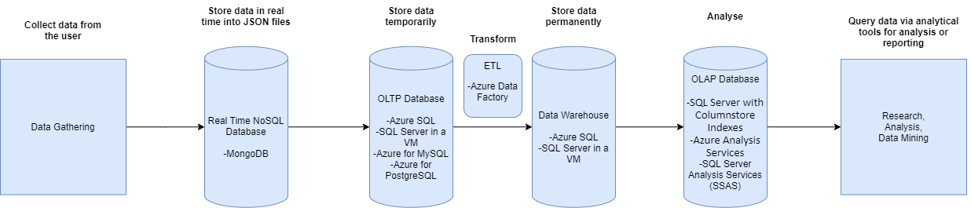
Typical Workflow of the Pipeline

Slide 8
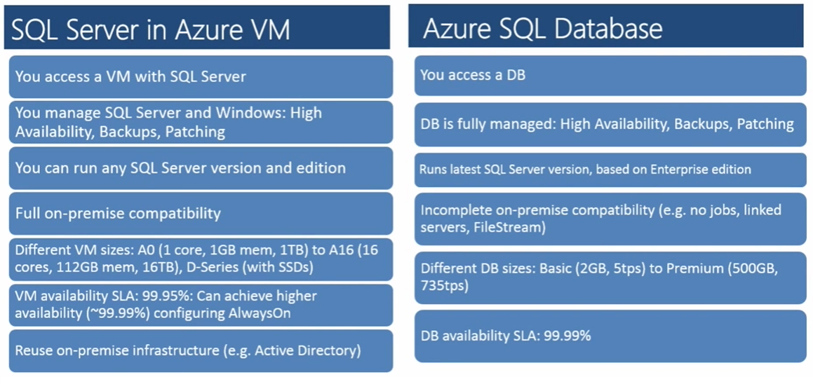
Differences between SQL Server in a VM and Azure SQL Database

Slide 9
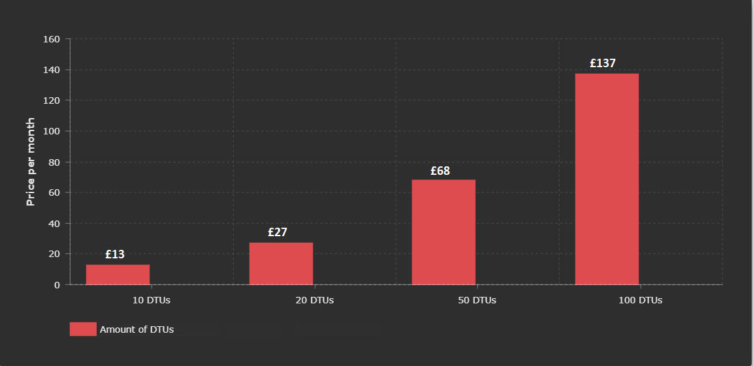
Pricing of Azure SQL Database using DTUs (Data Transfer Units)
250 GB of Storage Space

Slide 10
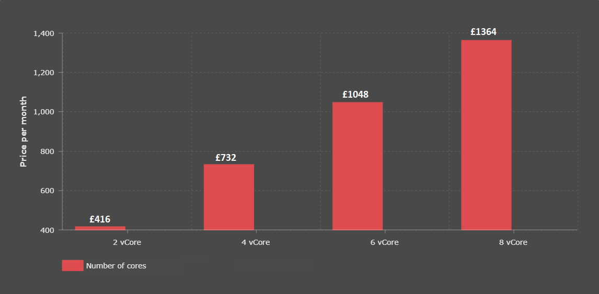
Pricing of Azure SQL Database using vCore
1 TB of Storage Space

Slide 11
Conclusion
-Type of database: OLTP
-Database: Azure SQL or Azure SQL in a VM
-Task at hand: extract the information from MongoDB and store it in Azure SQL as a permanent solution

Slide 12


